Slide 1
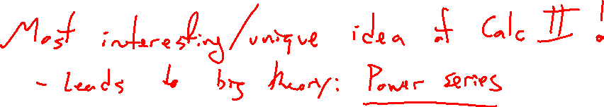
Chapter 11 Infinite Sequences and Series
Notes:
Most interesting / novel idea of this class. Grows to a large and powerful theory (Taylor Series).

Slide 2
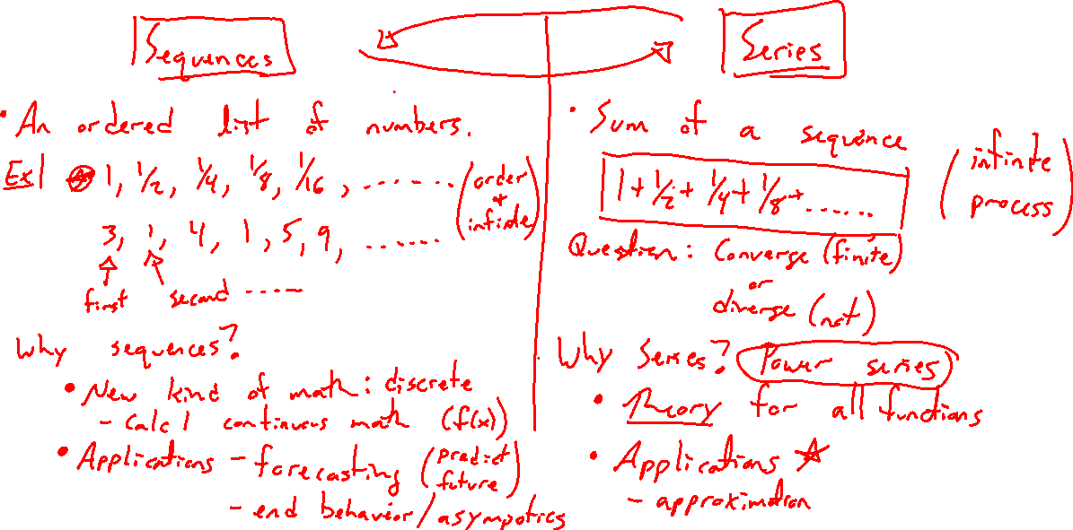
Sequences vs Series
Notes:
Basics
Sequences: New view of discrete math vs continuous math
Series: Two motivations, theory and approximation. Desmos demonstration of geom series and sine series.

Slide 3
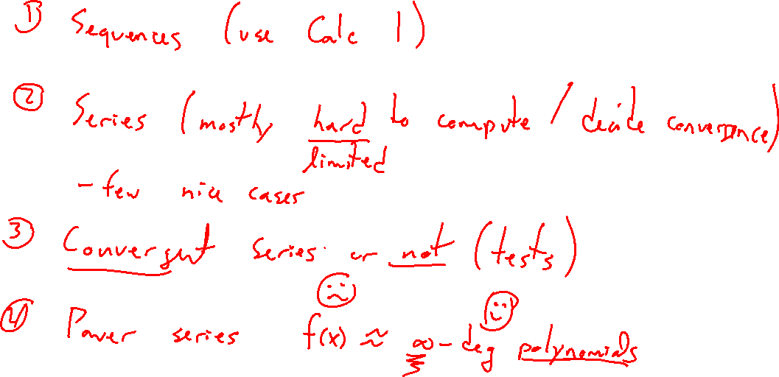
Outline of Chapter
Notes:
Transfer continuous calculus ideas into sequences
Basics of series, hard to compute sums most of the time
Series convergence / divergence
Power series, a general theory of functions, one of the most useful tools of theoretical math

